Slide 1
Building a Broucher Site

Slide 2
Installing Wordpress

Slide 3
Explore Wordpress Files & DataBase
Changing Website URL
Changing User Name
Editing functions.php

Slide 4
Wordpress Defaults

Slide 5
Configure Default Settings

Slide 6
Generating Salt Key

Slide 7
Installing Some Plugins

Slide 8
Contact Form 7
WP Mail SMTP
Email Protection
Google Maps
Google Analytics

Slide 9
Static Home Page & Posts

Slide 10
Creating Navigation & sidebar

Slide 11
Configure Contact Form
Make Google Account Two Step Verification Off
Make Google Account Less Secure

Slide 12
Configure Google Maps
https://console.developers.google.com/apis/dashboard

Slide 13
Configure Google Analytics

Slide 14
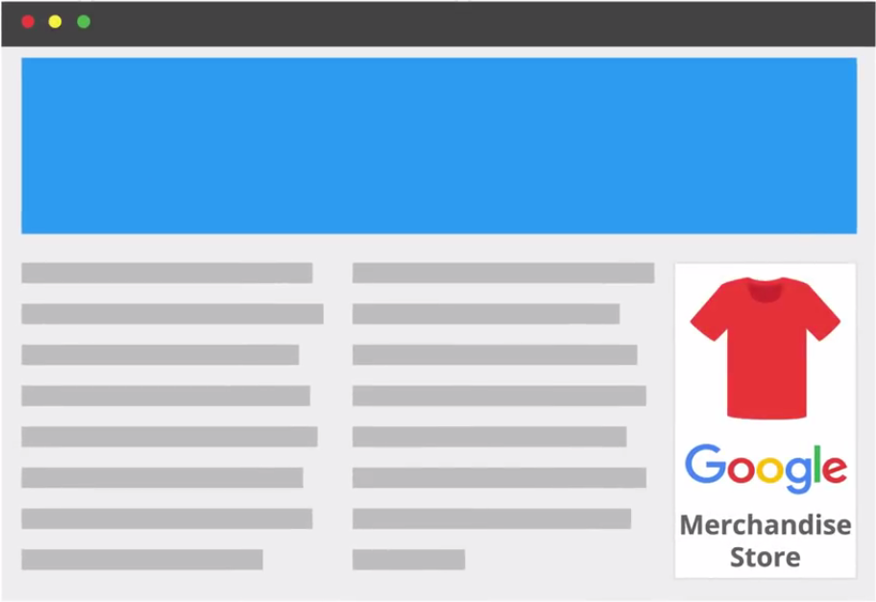


What can do with Google Analytics?
Google Merchandise Store
Analyse Geogrphical Sale Data

Slide 15
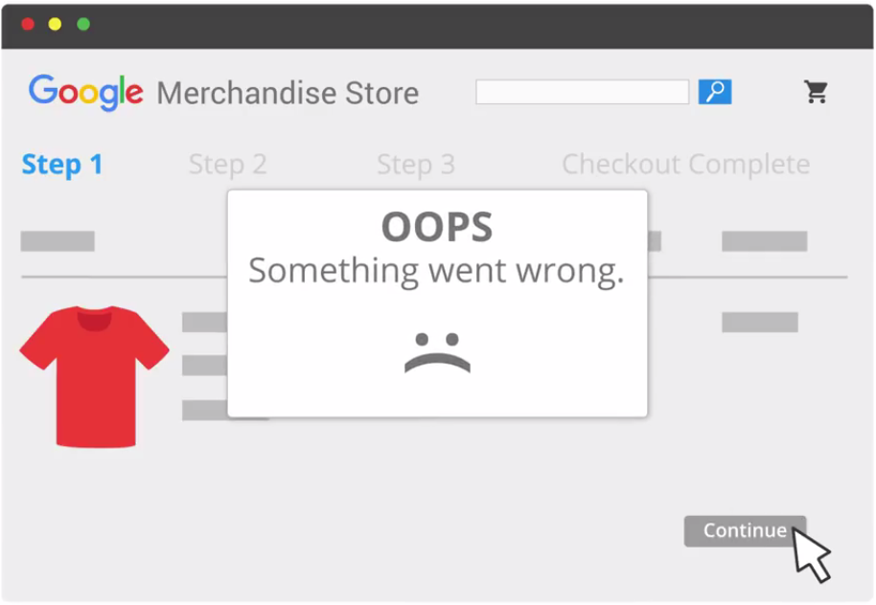

Slide 16
Different Kinds of Businesses Can Benefit From Digital Analytics
Publishers can used it to create a loyal, highly-engaged audience and to better align on-site advertising with user interests.
Ecommerce businesses can use digital analytics to understand their customers online purchasing behavior and better market their products and services.
Lead generation sites can collect user information for sales teams to connect with potential leads.

Slide 17
Digital Analytics can collect user behavioral data from a variety of systems such as –
Mobile Apps
Online point-of-sales systems
Video Game Consoles
Customer Relationship Management Systems
Internet-connected platforms

Slide 18
What is Google Analytics?
Google Analytics is a platform that collects data and compiles it into useful reports.

Slide 19
How to track a Web Site?
Create Google Analytics Account ( http://analytics.google.com )
Add a small piece of javascript tracking code to each page on your site.

Slide 20
What data can collect Tracking Code?
Browser Language
Type of Browser ( Chrome or Safari )
Device and Operating System
Traffic Source
( Search Engine, Advertisement, Email Marketing Campaign )

